Slide 1





BAT ALGORITHM
PROJECT
PROJECT: SMART SYSTEM
INSTRUCTOR: DR.BUI MINH DUONG
TEAM 13
LE THI NGOC DIEP 16090
LE QUOC DINH 10221009
NGUYEN HAI DUONG 10221012

Slide 2
INTRODUCTION
MATLAB 2022b is a lead main code deployment tool
MATLAB also used for visualizing result graphs
Simulink 2022b for designing circuit
Problem: Implementation of BAT Algorithm as Maximum Power Point Tracking Technique for Photovoltaic System Under Partial Shading Conditions
1

Slide 3

Problem Research
BAT Algorithm and Tracking MPPT Technique
2

Slide 4
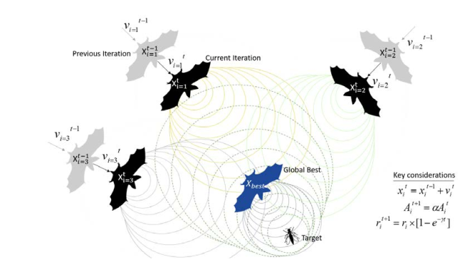
BAT Overview
Inspired by how bats use ultrasonic pulses to find prey
Developed by Xin-She Yang, in 2010
Uses loudspeakers and frequency adjustments to guide virtual bats through complicated search areas and identify optimal solutions.
3

Slide 5
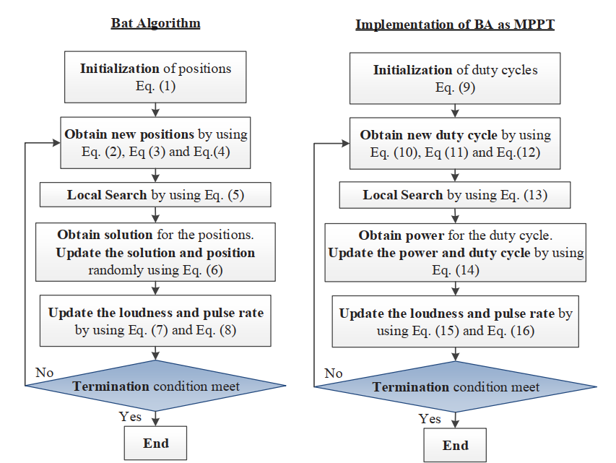
Flowchart
4

Slide 6
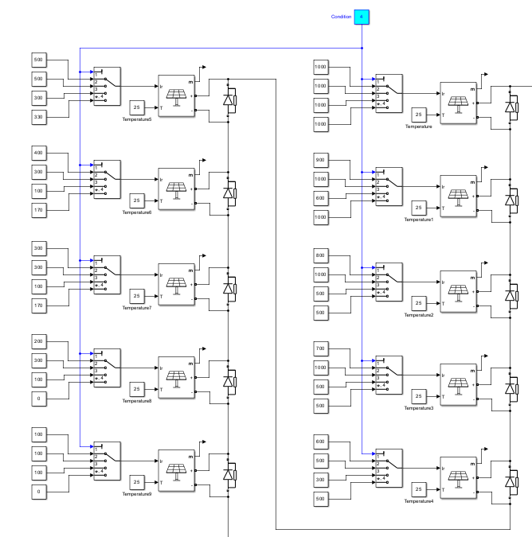
Partial Shading Conditions
Condition A: each module
gradually decreased from 1k W/m2 to 100 W/m2
Condition B: 4 - 1k W/m2, 2- 500W/m2, 3- at 300W/m2 and 1-100 W/m2
Condition C: 1- 1k W/m2, 1- 600W/m2,2- 500W/m2,2- 300W/m2 and 4- 100W/m2
Condition D: 2-1k W/m2, 3- 500W/m2,1- 330W/m2 ,2- 170W/m2 and 2- fully shaded.
5

Slide 7
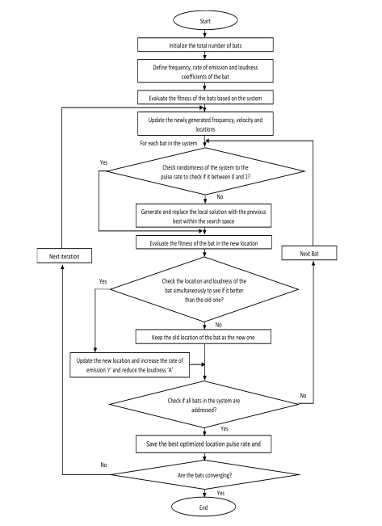
6

Slide 8
Code Deployment
function D = BAT(Vin,Iin)
coder.extrinsic('randi')
persistent u;
persistent i;
persistent j;
persistent k; % Iterations
persistent DP; % DutyCycle
persistent DPcurrent; % Current DutyCycle
persistent v; % Velocity
persistent F; % Frequency
persistent Fmax; % Maximum frequency
persistent Fmin; % Minimum frequency
persistent A; % Loudness
persistent r; % Pulse emission rate
persistent bestDP;
persistent DPcontainer;
persistent DPfitness;
persistent P; % Power
persistent Pfitness;
persistent counter; % Counter
persistent lb; % Lower boundary
persistent ub; % Upper boundary
persistent ro; % Initial pulse emission rate
persistent alpha; % Constant for loudness update
persistent gamma; % Constant for emission rate update
persistent eps;
persistent Pprev;
persistent bool;
persistent closeness;
persistent index;
7

Slide 9
Code Deployment
%initialization
if (isempty(counter))
counter=0;
bool=0;
index=0;
closeness=false;
Pprev=Vin*Iin;
k=0; % Iterations
lb=0; % Lower boundary
ub=1; % Upper boundary
DPcurrent=0.5; % Current DutyCycle
DPcontainer=zeros(4,1);
DPfitness=zeros(4,1);
Fmax=0.5; % Maximum frequency
Fmin=0.3; % Minimum frequency
A=rand(4,1); % Loudness for each DutyCycle
r=rand(4,1); % Pulse emission rate for each DutyCycle
8

Slide 10
Code Deployment
u=0;
i=0;
v=zeros(4,1); % Velocities
F=zeros(4,1); % Frequency
P=zeros(4,1); % Power
Pfitness=zeros(4,1);
alpha=0.5; % Constant for loudness update
gamma=0.5; % Constant for emission rate update
ro=0.67; % Initial pulse emission rate
DP=zeros(4,1); % Dutycycles
%initial dc for each particle
DP(1)=0.2;
DP(2)=0.4;
DP(3)=0.6;
DP(4)=0.8;
end
9

Slide 11
Code Deployment
% At the first time, this if ignored (counter=0)
% Delay
if(counter>=1 && counter<300)
D=DPcurrent;
counter=counter+1;
return; % return control to the invoking function before it reaches the end of the function.
end
counter=0; % reset the counter
% calculate the fittnes function (power) of each particle
% then compare the current value of the function with the previous one
% if the current value is better than the previous, update the value
% Note: at the first time, this if ignored (u=0)
if(u>=1 && u<=4)
P(u)=Vin*Iin;
DPcontainer(u)=DPcurrent;
end
10

Slide 12
Code Deployment
% Update if the solution improves, or not too loud
if(u>4)
for i=1:4
if (P(i)>=Pfitness(i))
Pfitness(i)=P(i);
DPfitness(i)=DPcontainer(i);
if(k>=1)
A(i)=alpha*A(i);
r(i)=ro*(1-exp(-gamma*k));
end
end
end
end
u=u+1;
% AT the first time, this is excuted because it consist the condition...
% u==0 (initial value of u)
if(u==6)
u=1;
end
11

Slide 13
Code Deployment
if(u==5)
if(bool==0)
k=k+1;
end
[Pmax,index]=max(Pfitness); % finds the indices of the maximum values of P (max power) and aaaaaaaaaaaaaaaaaaaaaaaaaaaaaaaa returns them in output vector "index"
bestDP=DPfitness(index); % find the location(duty) of the particle which has max Power
if(bool==0)
D=bestDP;
else
D=DP(index); %mean
end
DPcurrent=D;
counter=1;
12

Slide 14
Code Deployment
for i=1:4
F(i)=Fmin+(Fmax-Fmin)*rand; %randomly chose the frequency
v(i)=v(i)+(DPfitness(i)-bestDP)*F(i); %update the velocity
if DPfitness(i)>bestDP
DP(i)=DPfitness(i)-abs(v(i)); %update the Dutycycle position
else
DP(i)=DPfitness(i)+abs(v(i)); %update the Dutycycle position
end
%Checking bounds/limits
if DP(i) < lb % Check the lower limit
DP(i) = lb;
elseif DP(i) > ub % Check the upper limit
DP(i) = ub;
end
13

Slide 15
Code Deployment
%check the condition with r
if rand>r(i)
eps=-1+(1-(-1))*rand;
DP(i)=bestDP+eps*mean(A);
end
end
if(bool==0)
closeness=true;
for i=1:4
for j=1:4
if(i~=j)
closeness = closeness & (abs(DP(i)-DP(j))<0.1); %0.05
end
end
end
end
14

Slide 16
Code Deployment
%if the power stables already
if(bool==1 )
%check if the power changes
if(abs(Vin*Iin-Pprev)/Pprev >= 0.05) %0.1
DPcurrent=0.5; % Current DutyCycle
DPcontainer=zeros(4,1);
DPfitness=zeros(4,1);
A=rand(4,1); % Loudness for each DutyCycle
r=rand(4,1); % Pulse emission rate for each DutyCycle
v=zeros(4,1); % Velocities
F=zeros(4,1); % Frequency
P=zeros(4,1); % Power
Pfitness=zeros(4,1);
DP=zeros(4,1); % Dutycycles
DP(1)=randi([5 250])/1000;
DP(2)=randi([250 500])/1000;
DP(3)=randi([500 750])/1000;
DP(4)=randi([760 995])/1000;
bool=0;
end
end
15

Slide 17
Code Deployment
if(closeness==1)
bool=1;
closeness=false;
end
if(k>100)
DPcurrent=0.5; % Current DutyCycle
DPcontainer=zeros(4,1);
DPfitness=zeros(4,1);
A=rand(4,1); % Loudness for each DutyCycle
r=rand(4,1); % Pulse emission rate for each DutyCycle
v=zeros(4,1); % Velocities
F=zeros(4,1); % Frequency
P=zeros(4,1); % Power
Pfitness=zeros(4,1);
DP=zeros(4,1); % Dutycycles
DP(1)=randi([5 250])/1000;
DP(2)=randi([250 500])/1000;
DP(3)=randi([500 750])/1000;
DP(4)=randi([760 995])/1000;
k=0;
end
16

Slide 18

Code Deployment
Pprev = Vin*Iin;
return;
else
% update each particle's duty cycle, reset counter.
if(bool==0)
D=DP(u);
else
D=DP(index); % mean
end
DPcurrent=D;
return;
end
end
17

Slide 19
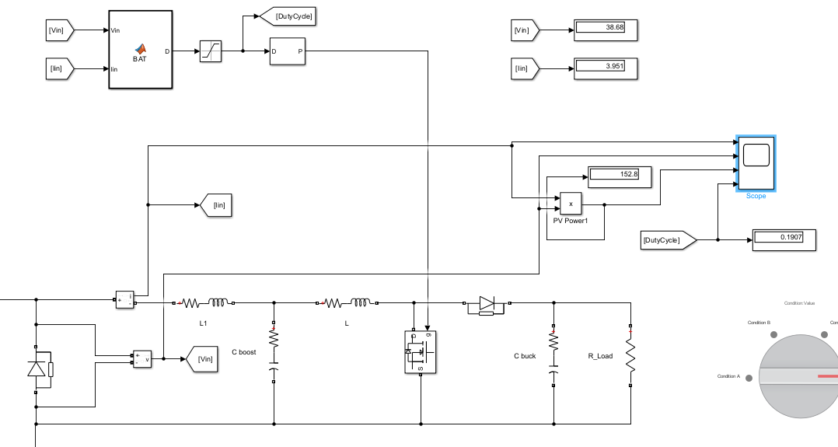
18

Slide 20
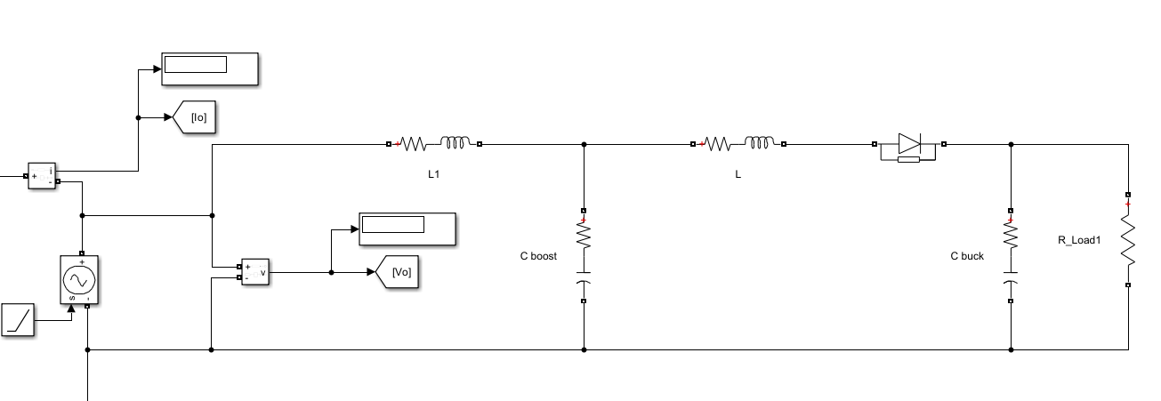
When we apply load to simple PV circuit with around (2 or 3 series modules) -> it will immediately create stable value for Current and Voltage.
But in complex PV circuit with 10 series modules -> it will take time to reach stable value for Current and Voltage
19

Slide 21
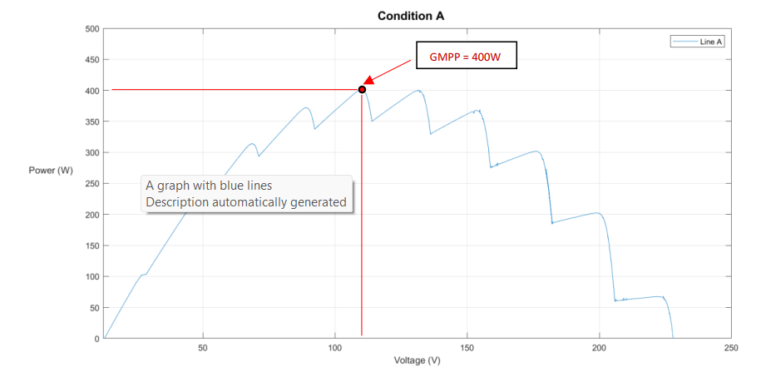
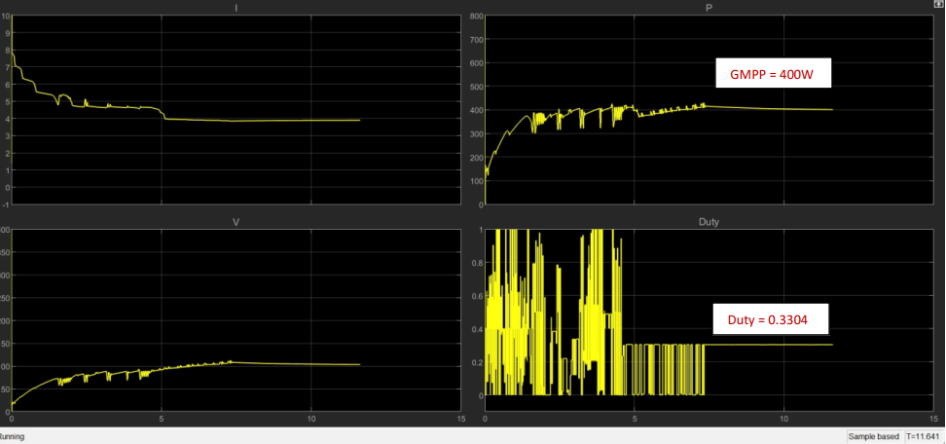
Condition A
GMPP = 400W
Duty = 0.3304
20

Slide 22
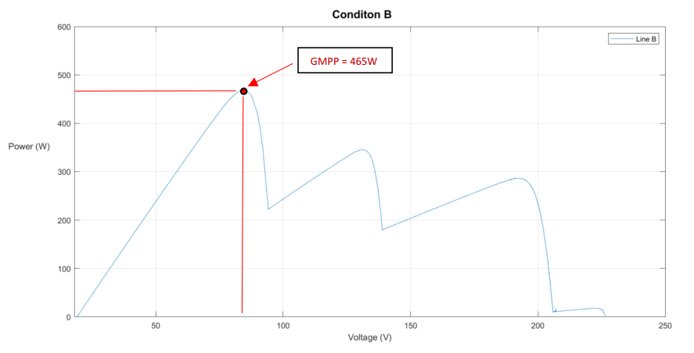
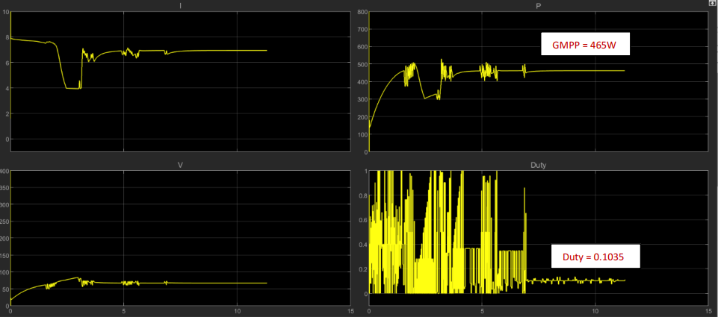
Condition B
GMPP = 465W
Duty = 0.1035
21

Slide 23
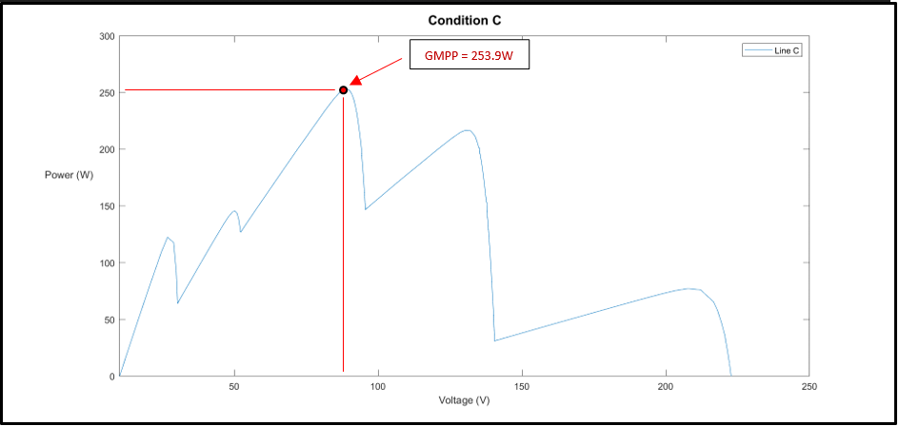
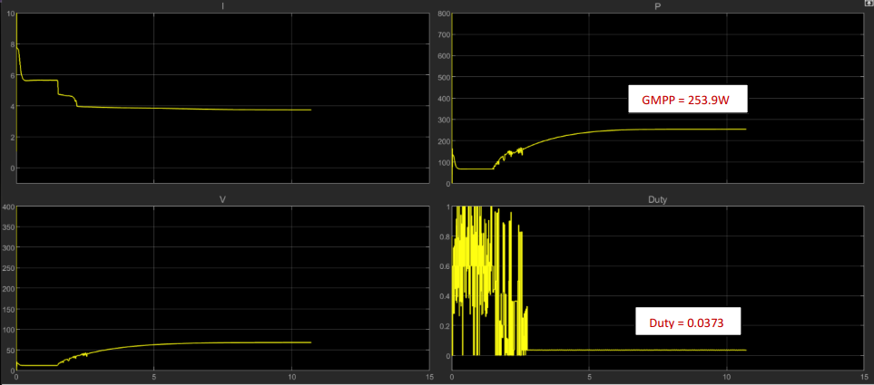
Condition C
GMPP = 253.9W
Duty = 0.0373
22

Slide 24
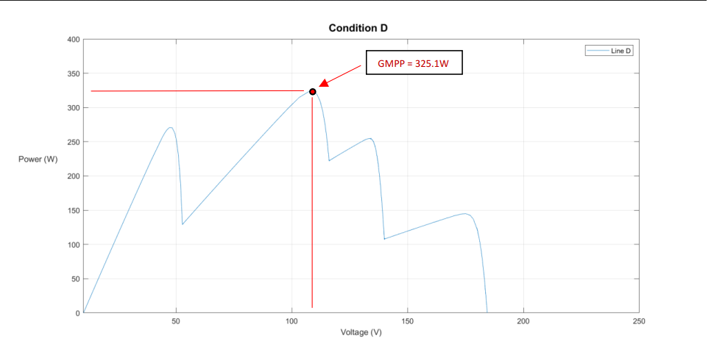
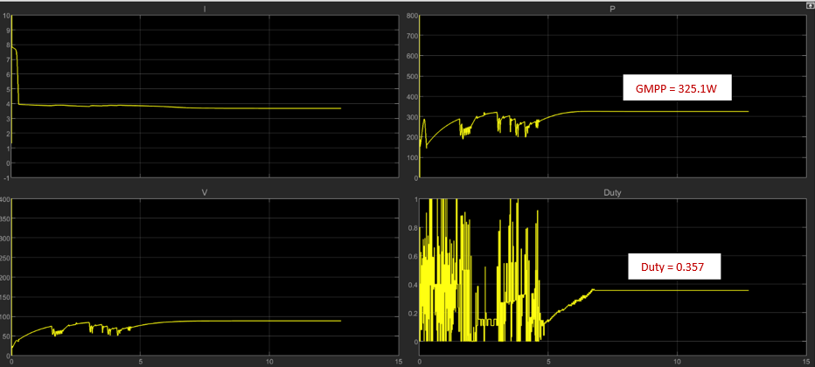
Condition D
GMPP = 325.1W
Duty = 0.357
23

Slide 25

Conclusion
In summary:
The BAT algorithm has revealed potent answers in the shadows
Demonstrating that often the quietest solutions come from nature
“ Embrace the BAT, navigate the dark, and illuminate solutions unseen”
24

Slide 26









Q & A TIME!!
P/S: PLEASE BE EASY ON US
TALK TO US
16090@student.vgu.edu.vn
10221012@student.vgu.edu.vn
10221009@student.vgu.edu.vn

